Slide 1
Model Calibration
Tess Ryckman
Weekly TB Research Group Meeting
15 Feb 2022

Slide 2
TB Prevalence Survey Data
Reported TB Notifications
No TB Disease
Subclinical Active TB
Symptom Progression
Clinical Active TB
Inflows
Incidence
Treatment
Deaths
Many model parameters cannot be directly measured
But observed data can tell us about these unknown parameters
Model Calibration: process of identifying parameters that generate model output which matches observed data

Slide 3
Overview for today
Calibration basics and terminology
Types of calibration
Tips and tricks
Worked examples
Q&A

Slide 4
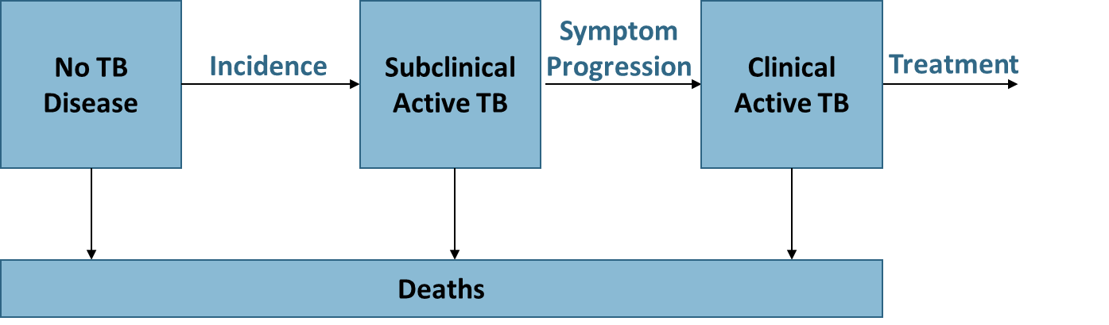
Terminology
Outputs
Subclinical TB prevalence
Model & parameters
Clinical TB prevalence
Number of treated TB cases
Goodness of fit score
Parameters: model inputs
Targets: empirical data to be replicated by the model
Outputs: modeled outcomes to be matched to targets
Goodness of Fit function: quantitative metric to assess model’s performance in replicating targets
Targets
Reported TB Notifications
TB Prevalence Survey Data

Slide 5
Terminology
Parameters: model inputs
Targets: empirical data to be replicated by the model
Outputs: modeled outcomes to be matched to targets
Goodness of Fit function: quantitative metric to assess model’s performance in replicating targets
Prior: initial information about a parameter (could be applied as constraints or a prespecified parameter distribution)
Identifiability: targets can feasibly inform all parameter values
Often, a model is identifiable if # parameters = # targets

Slide 6
Common calibration targets
Notifications – e.g. cases reported by passive surveillance systems
Prevalence survey data – e.g. cases reported using active surveillance, door-to-door screening, etc.
Deaths – typically more reliably estimated than cases even w/ passive surveillance
Intervention impact – if model includes interventions with unknown efficacy
Targets can be stratified by age, sex, location, drug-resistance, severity, etc.
Target selection should fit the model

Slide 7
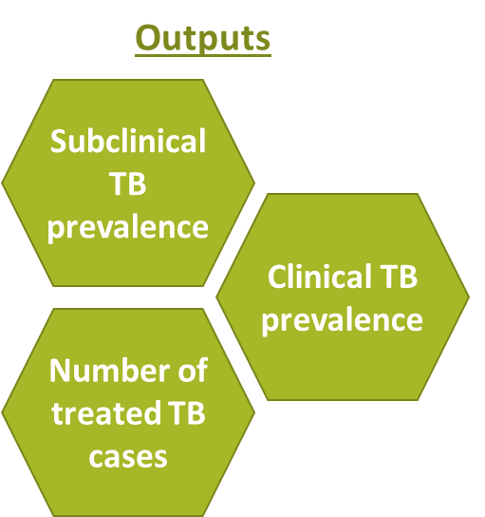
Common goodness of fit functions
Distance: measures “distance” between targets and model output
Sum of squared errors (SSE)
Weighted SSE
Likelihood: measures “likelihood” of observing calibration targets given the model outputs
Assign probabilistic distribution (e.g. normal, binomial) to target data
Maximizing likelihood = maximizing log likelihood. Log likelihood can be easier to optimize over.
Accept/Reject: accept parameter sets if they meet some specified criteria, reject if they do not
SSE or likelihood within some threshold
Fit within 95% CIs or IQRs of targets

Slide 8
4 main calibration types
Analytic: solve for parameters directly (i.e. analytically, mathematically, etc.)
Random search: try random sets of parameters and pick the one(s) that best replicate targets
Directed search: use optimization algorithms (simplex, gradient-descent) to efficiently find a single best-fitting parameter set
Bayesian calibration: synthesize prior evidence and calibration targets to identify posterior parameter distributions

Slide 9

Directed search calibration methods
AKA optimization, iterative search
Algorithms find local optima that maximize the goodness of fit
Simplex/Nelder-Mead
Gradient Descent
Genetic algorithms
Simulated annealing
Only finds 1 “best-fitting” parameter set
Can get stuck at local minima – try different starting points
Good starting place – simple & efficient
SSE(p1)
x
x
x
x
x
x
x
Parameter p1

Slide 10
Random search calibration methods
Grid search
Run model for all combinations of parameter values in a grid
Typically infeasible for > 2 parameters
Random search
Randomly sample parameter sets from probabilistic distributions
More feasible but can achieve poor coverage if many parameters
Random search w/ LHS
Latin Hybercube Sampling is a technique that enables better coverage of the full parameter space
How to combine multiple good-fitting parameter sets?
Source: Fernando Alarid-Escudero & Eva Enns
x
x
x
x
x
x
x
x
x
x
x
x
x
p2
p1
p1
p1

Slide 11
Bayesian calibration methods
Sampling Importance Resampling (SIR)
Incremental Mixture Importance Sampling (IMIS)
Markov Chain Monte Carlo (MCMC)
Approximate Bayesian Computation (ABC)

Slide 12
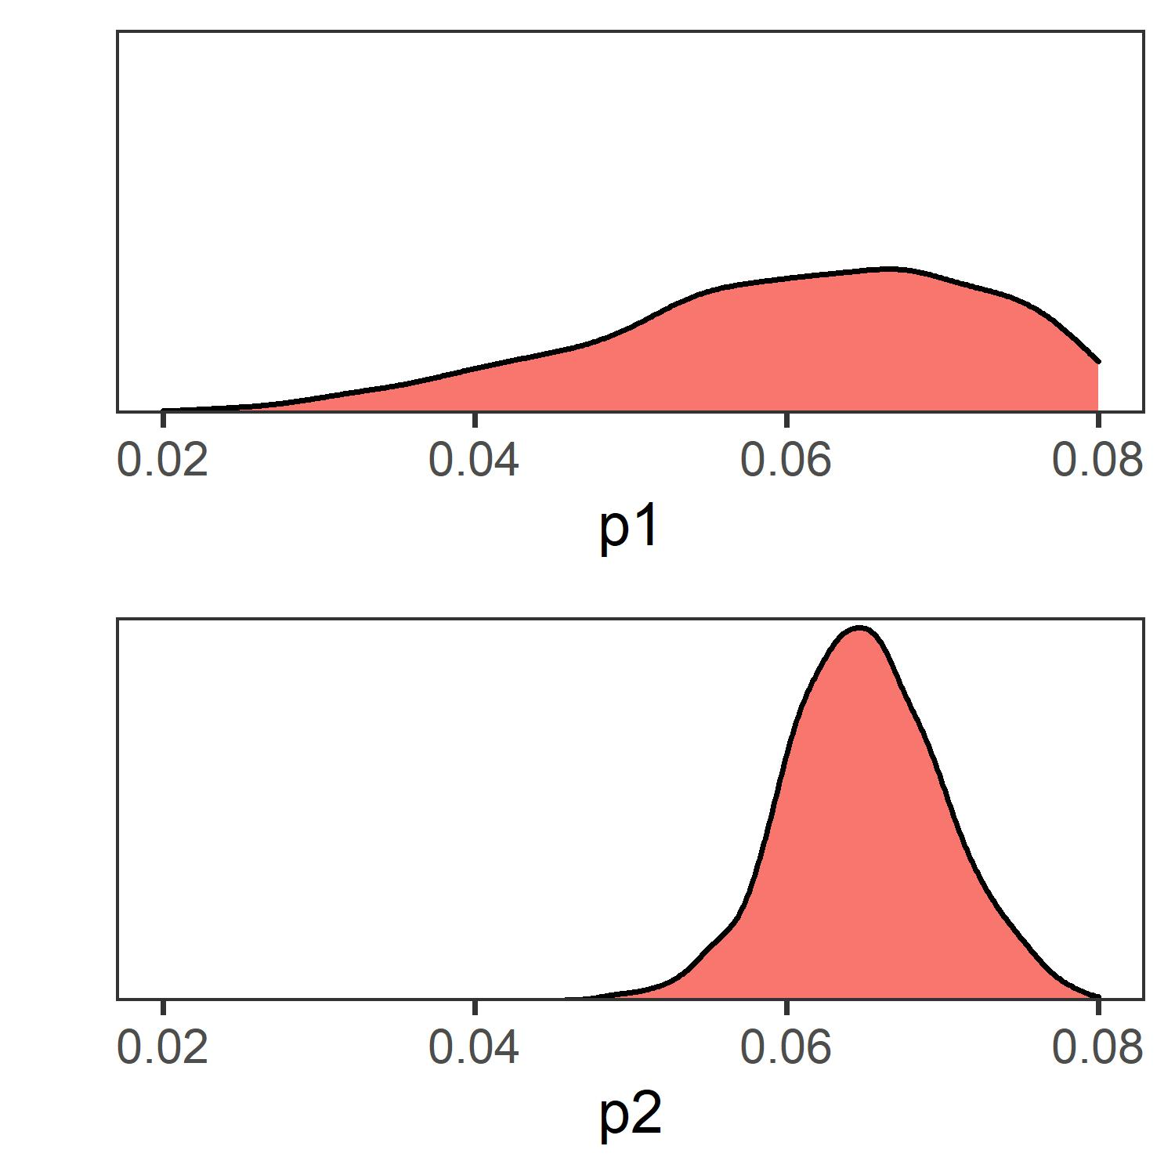
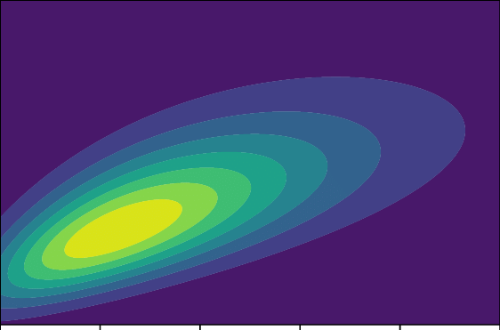
Bayesian calibration methods: SIR
Sampling Importance Resampling
Starts out like random search
Compute likelihood-based sampling weights for each parameter set
higher likelihood = higher probability of being sampled
Weighted sampling of parameter sets, with replacement
Result: many parameter set samples form posterior distribution
x
x
x
x
x
x
x
x
x
x
x
Higher sampling weight
x
x
x
x
x
x
x
x
x
x
x
x
x
x
x
p2
p2
Lower sampling weight
p1
p1

Slide 13
Bayesian calibration methods: MCMC
Markov Chain Monte Carlo
Simulates posterior distribution by “jumping” around the parameter space
Random jumps are “proposed”
Jumps are “accepted” based on an algorithm, like the new location having higher likelihood than the current location (but more complicated…)
Numerous algorithms that implement MCMC: Metropolis-Hastings (MH), etc.
Source: Fernando Alarid-Escudero

Slide 14
Bayesian calibration methods
Sampling Importance Resampling (SIR)
Simple + easy add-on to random search
Can be inefficient if many parameters
Incremental Mixture Importance Sampling (IMIS)
Starts out like SIR, adds more dense sampling in areas of highest likelihood
More complex, but improves efficiency
Both SIR and IMIS can get “stuck” – solution is to run separate “chains”
Markov Chain Monte Carlo (MCMC)
Most common Bayesian calibration technique
MCMC can also “get stuck” – solution is run multiple MCMCs from different starting points
Approximate Bayesian Computation (ABC)
Used when likelihood function cannot be defined or is intractable to calculate
Example: SIR, but with accept/reject

Slide 15
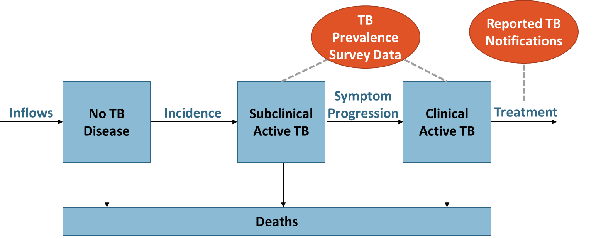
Worked examples
Prevalence: 1159 cases/100,000
Proportion Clinical: 32%
Notifications: 403 notifications/100,000
Calibrating rates of incidence, symptom progression, and treatment to data from the Philippines
Mortality rates are fixed
Directed search, random search, SIR using likelihood-based goodness of fit

Slide 16
Calibration tips and tricks
How to choose your prior parameter distributions?
Parameter Type | Range | Distribution(s) | Uninformed Prior
Probability | [0, 1] | Beta | Beta (1, 1)
Rate | [0, infinity] | Lognormal, Gamma, or Normal | Uniform (0, large number)
Relative Risk (unconstrained) | [0, infinity] | Lognormal
Relative Risk (constrained) | [0, 1] | Beta | Beta (1, 1)

Slide 17
Calibration tips and tricks
How to choose your target distributions (for likelihood-based methods)
Target Type | Distribution(s) | Details
Proportion (or anything else that falls between 0 and 1) | Beta (or Binomial) | Alpha = # ppl with an outcome (like # TB cases in a survey) Beta = # ppl without an outcome (like # ppl in a survey that didn’t have TB)
Count Data | Poisson or Negative Binomial | Negative binomial allows for more uncertainty than Poisson
Time to Event | Exponential | For example, average or median survival time
Other | Normal, Lognormal, Gamma | If you have a target and you’re not sure what distribution to use, these are all common. If you have confidence intervals, you can choose the distribution that best fits those confidence intervals

Slide 18
Calibration tips and tricks
How to choose your goodness of fit function?
SSE can be a helpful starting point
Likelihood-based = most tractable across different types of calibration methods
How to choose your calibration method?
Optimization or random search can be helpful starting points
Bayesian calibration = ideal, provides distributions for PSA. Efficiency tradeoffs.
SIR and IMIS are easier to scale than MCMC
How to select calibration targets?
Start with standard targets (notifications, prevalence survey data), but be creative
Consider whether your targets match what you’re trying to do. If your model is age-stratified, do you have age-stratified targets?
Some targets may need adjustment before they match modeled output (notifications ≠ all cases)
Do you have enough targets for your model to be identifiable?
How to increase efficiency?
Narrow priors (e.g. face validity, very inconsistent outputs)
Use Latin Hypercube Sampling
Separate calibration into nonoverlapping phases if possible
Anything that involves evaluating many random samples can be parallelized (e.g. on a server or high-performance computing cluster like MARCC)
Sampling methods (SIR, IMIS, random search) – how do you know you have enough samples?
Posterior parameter distributions should look smooth, not change much if you add more samples or rerun calibration
It’s an iterative and somewhat subjective process!

Slide 19
Questions to ask yourself when you read a modeling paper
Which parameters are calibrated?
Does the model assume values for some unknown parameters or does it incorporate all unknown parameters in calibration?
How well is calibration described?
Does the appendix provide details on targets/distributions/their sources, calibration method, GOF function, etc.?
Does the appendix show calibration performance? (e.g. calibrated model output fit to targets, what the best-fitting parameter values or posterior distributions are)
Does the method allow for parameter uncertainty?
There is always uncertainty – but is this reflected or was one single best-fitting parameter chosen?
Bayesian calibration methods are typically strongest at incorporating uncertainty
Does the method consider applicability of target data to the model?
For example, notifications are a biased estimate of true TB cases. Does the model consider that only some cases are treated/notified? Or, was the target adjusted to reflect uncertainty in notification coverage?
Does the choice of calibration targets fit with what the model is trying to do?
If the model is focused on programs that target certain age groups, or interventions related to drug resistance, were calibration targets related to age-specific TB burdens/drug resistance included?

Slide 20
R packages and functions
Latin Hypercube Sampling: lhs
Optimization algorithms: optim (method = “L-BFGS-B” allows you to specify parameter bounds), DEoptim, optim_sa, GenSA
IMIS: IMIS (no longer maintained?)
MCMC: RStan, R2WinBUGS, rjags, mcmc
Bayesian calibration organization/wrapper functions: darthpack and dampack (also helpful for running PSAs, VOI analysis, etc.)
For sampling: rnorm, rbeta, rgamma, etc.
For likelihood evaluation: dnorm, dbinom, dbeta, etc.

Slide 21
Excel add-ins and functions
Likelihood calculations: BETA.DIST, NORM.DIST, etc.
Directed Search: “Solver” add-in
Random Search and SIR:
Random parameter set sampling: RANDBETWEEN(a, b) samples random numbers between a and b.
Evaluating the model for each parameter set: requires VBA/macros
To conduct weighted sampling:
Calculate sampling weights and create a column that sums them across rows (cumulative weight). Say this is column M and that your spreadsheet has 1 header row
MATCH(RAND(), M$2:M$5001) + 1 will randomly sample integers corresponding to the row index (with sampling weights)

Slide 22
Additional resources
Calibration Overviews/Tutorials:
Menzies et al. Bayesian Methods for Calibration Health Policy Models: A Tutorial Pharmacoeconomics, 2017. doi.org/10.1007/s40273-017-0494-4
Vanni et al. Calibrating Models in Economic Evaluation. Pharmacoeconomics, 2012. dx.doi.org/10.2165/11584600-000000000-00000
Original SIR and IMIS papers:
Rubin. Using the SIR algorithm to simulate posterior distributions (with discussion). In Bayesian Statistics 3 by Bernardo et al, 1988.
Teele et al. Computing Normalizing Constants for Finite Mixture Models via Incremental Mixture Importance Sampling (IMIS). Journal of Computation and Graphical Statistics, 2006. https://doi.org/10.1198/106186006X132358
Raftery and Bao. Estimating and Projecting Trends in HIV/AIDS Generalized Epidemics Using Incremental Mixture Importance Sampling. Biometrics, 2010. https://doi.org/10.1111/j.1541-0420.2010.01399.x
Examples/other resources:
Bayesian calibration example: Jackson et al. Calibration of Complex Models through Bayesian Evidence Synthesis: A Demonstration and Tutorial. Medical Decision Making, 2013. https://doi.org/10.1177%2F0272989X13493143
Tutorials, R code, worked examples: www.darthworkgroup.com
Specific concepts
Model Identifiability: Alarid-Escudero et al. Nonidentifiability in Model Calibration and Implications for Medical Decision Making. Medical Decision Making, 2018. https://doi.org/10.1177/0272989x18792283
Efficiency (in Bayesian calibration): Ryckman et al. Methods for Model Calibration under High Uncertainty: Modeling Cholera in Bangladesh. Medical Decision Making, 2020. https://doi.org/10.1177%2F0272989X20938683

